Slide 1

KAIROS
AI-Powered Emergency Identification, Dispatch & Hospital Routing
DeepStation Google Hackathon · Track: Community / Healthcare Access · Version 2.0 · May 2026
BUILT TO WIN
EVERY API IS REAL
END-TO-END LIVE DEMO

Slide 2
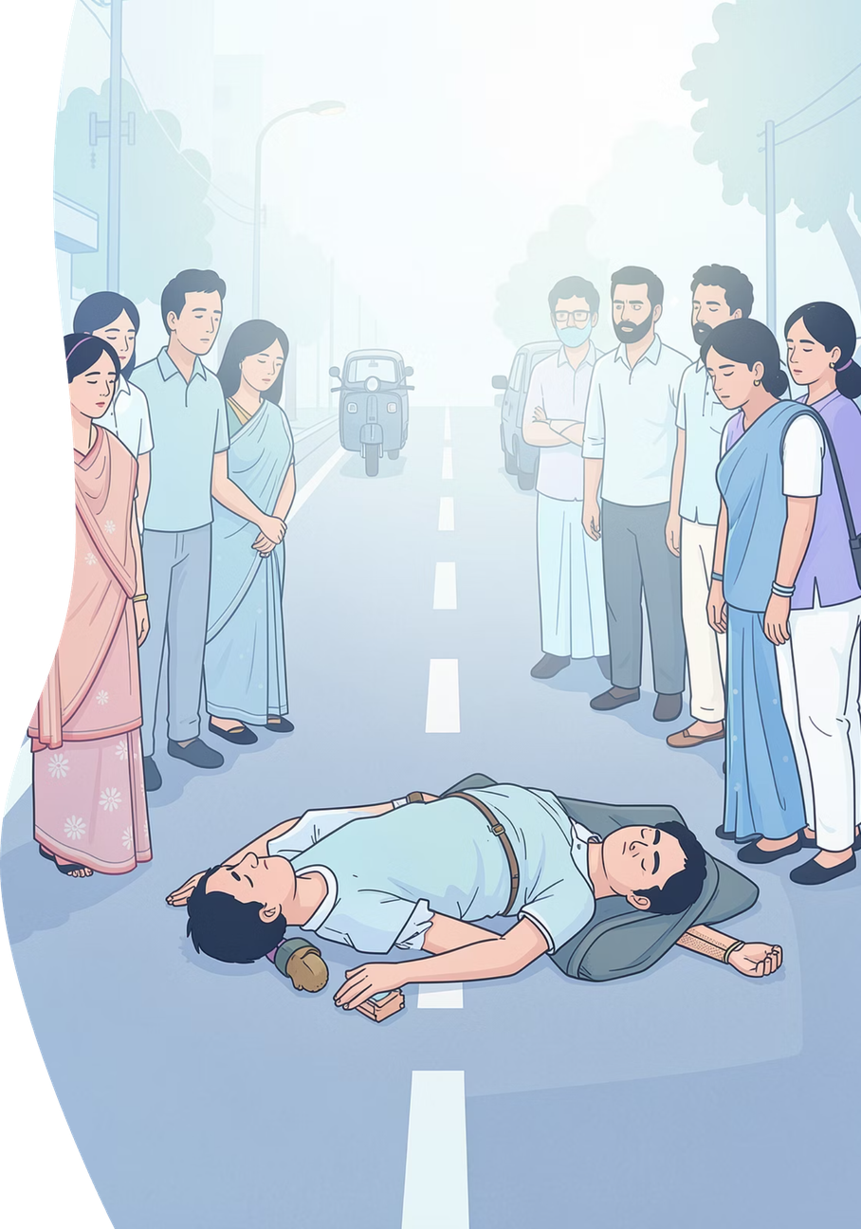

A Fatal Gap in Indian Emergency Response
🚨 Unknown Identity
Unconscious victims can't speak. ER doctors waste 20+ minutes finding blood group, allergies, and emergency contacts.
📊 Stale Bed Data
Hospital dashboards show beds taken 40 minutes ago. Ambulances arrive, find no room, and turn back.
🔗 No Full-Loop Owner
Practo handles discovery. Stanplus handles dispatch. Nobody owns end-to-end routing of a critical patient.
📵 Family Left in Dark
Emergency contacts are never automatically notified. Family finds out by accident — or hours later.
The information needed to save lives exists somewhere — it just cannot be reached fast enough.

Slide 3
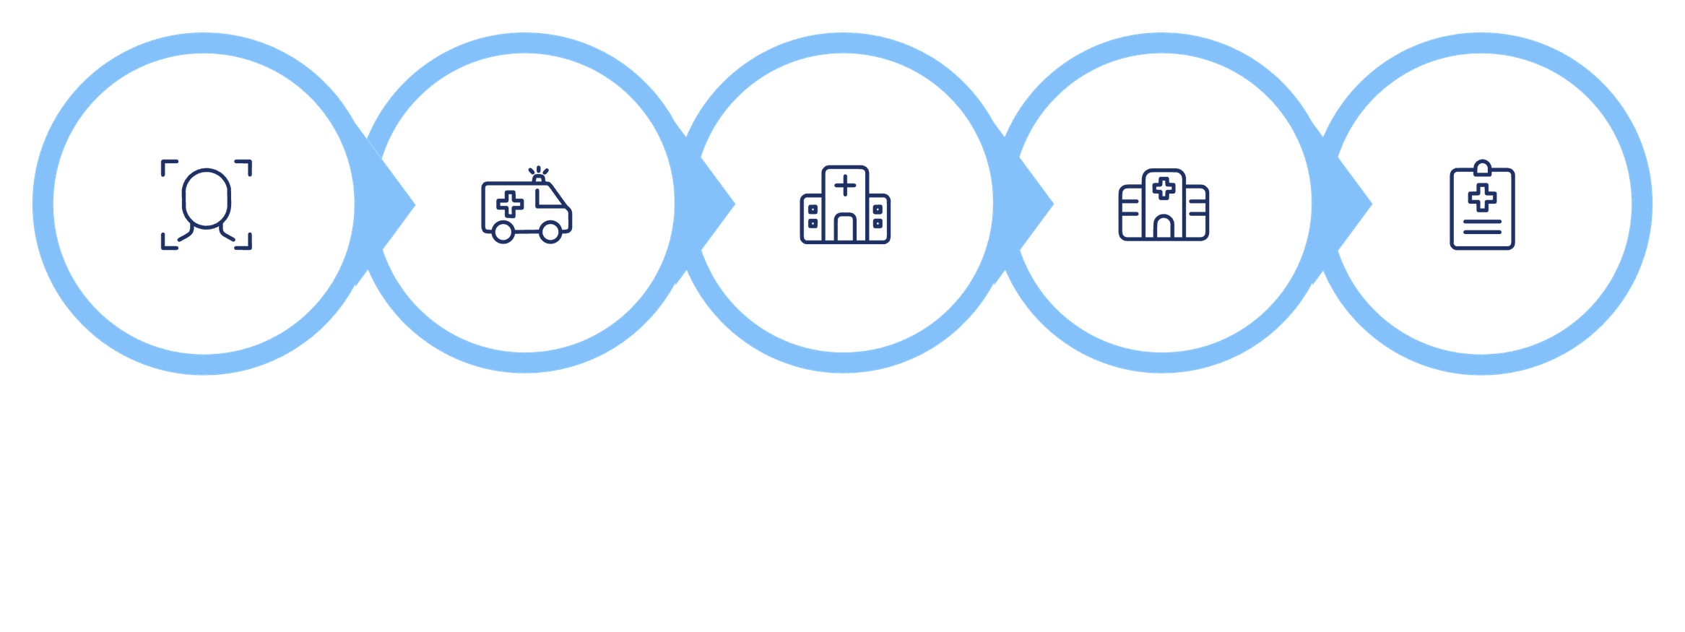





KAIROS: One Autonomous Loop
From a bystander's photo to a briefed ER team — entirely AI-driven, before the ambulance arrives.
Identify Victim
Dispatch Ambulance
Select Hospital
Brief ER Team
Verify Beds
Every stage runs on real APIs. Every decision is made by a real AI agent. No chatbot. No lookups. Autonomous action.

Slide 4

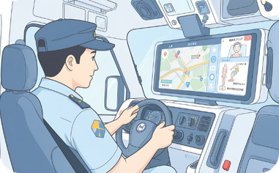
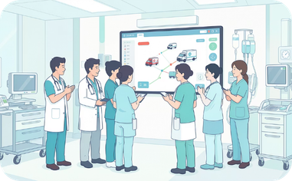
Three Dashboards. One Shared Reality.
Citizen / Bystander Dashboard
Ambulance Driver Dashboard
Hospital ER Dashboard
PWA opens directly to /emergency. Rear camera fires with 3-second auto-capture. Real-time status feed with zero silent moments. Live ambulance tracking map. Gemini first-aid guidance.
Receives dispatch via Telegram with full medical card. Gemini predicts what to prepare en route. Driver drives — the AI handles all hospital coordination in parallel. Never involved in routing decisions.
Full medical card and live condition arrive before the ambulance. Audio alert + red screen flash + SMS to charge nurse if unacknowledged within 2 minutes. Live ambulance marker on Google Maps.

Slide 5

Face Recognition in Under 10 Seconds
Why Local Model, Not Cloud API
Google Vision detects faces — it cannot match against a custom database. AWS Rekognition adds setup risk. DeepFace + ArcFace runs locally: free, no latency, works offline, 99.4% benchmark accuracy.
RetinaFace Detector
ArcFace Model
L2 / Cosine Match
Handles angles, poor lighting, partial occlusion
512-dim embedding per photo. Raw photos deleted after generation.
Distance < 12.0 = high confidence. QR code as parallel fallback.

Slide 6






The Multi-Agent Engine
Nine specialized agents. Real parallelism. Removing any one breaks the system — this is agentic AI, not a chatbot.
NER / Triage Agent
Orchestrator
Gemini 1.5 Flash extracts emergency type, bed type, specialist needed, and urgency from free-text companion input.
Pulls nearby hospitals, spawns parallel worker agents — one per hospital — and coordinates all results.
Voice Agent
Scoring Agent
Twilio places real call. Google TTS speaks. Google STT captures receptionist response. Gemini parses to JSON in English, Hindi, or Kannada.
Drive time first. Specialist match as tiebreaker within 500m. Decision explained in plain English on every dashboard.
First Aid + Prep Agents
Closer Agent
Gemini gives bystanders condition-aware DOs and DON'Ts. Tells ambulance crew exactly what to prepare en route.
Sends medical card + live condition to ER. Sends navigation to driver. Triggers Twilio SMS chain to emergency contacts.

Slide 7
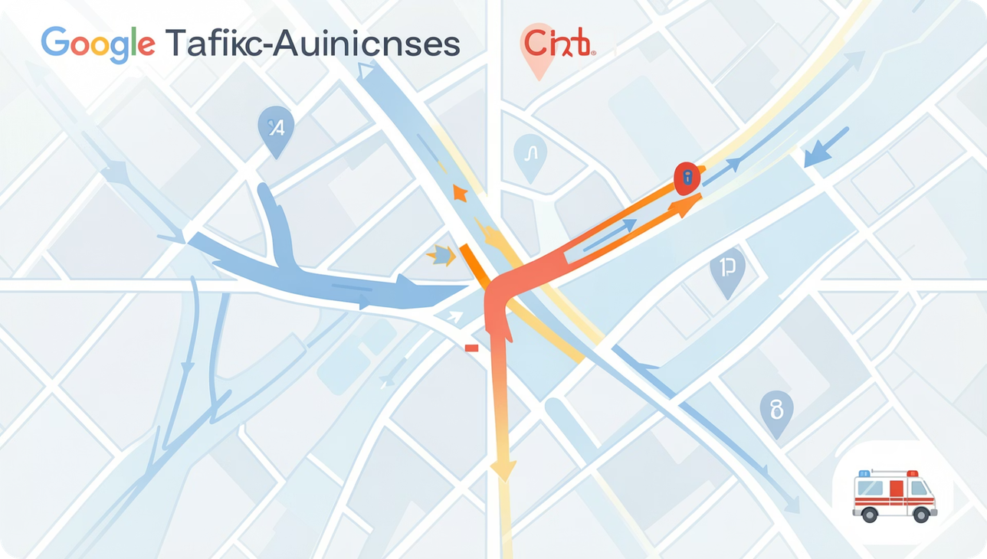
Ambulance Assignment: Nearest ≠ Fastest
Why Straight-Line Distance Fails
One-way streets, traffic signals, construction, and congestion make straight-line math dangerous. KAIROS uses Google Distance Matrix API with live traffic data.
Unit
Straight-Line
Actual Drive
Decision
AMB-001
1.0 km
9 min
Available
AMB-002
0.8 km
BUSY
Filtered Out
AMB-003
1.4 km
4 min
ASSIGNED ✓
ALS vs BLS capability filtering applied before distance scoring. Only available, qualified units compete.

Slide 8
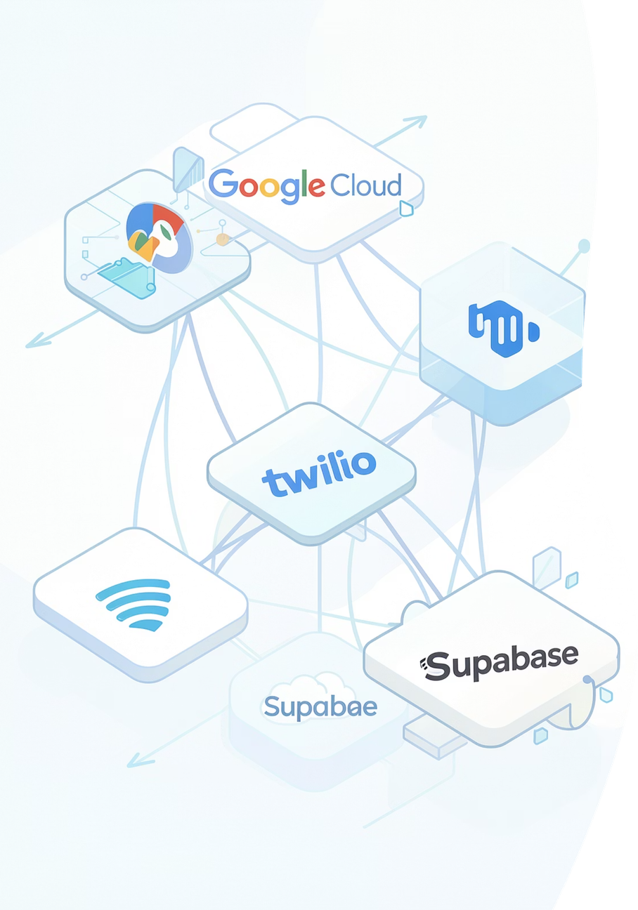
Google-Native. Real APIs. All Wired.
Google AI
Gemini 1.5 Flash across all 9 agents. Google STT/TTS for voice calls. $5 credits covers 500+ demo runs.
Google Maps Suite
Maps JS API · Distance Matrix API (live traffic) · Directions API · Geocoding API
Twilio
Real voice calls to hospital reception. SMS alerts to emergency contacts at every status change.
Supabase + DeepFace
PostgreSQL stores profiles and 512-dim ArcFace embeddings. Local model: free, offline-capable, zero latency.
Built with Google Antigravity scaffolding. Deployed via Next.js + FastAPI. Exposed to judges via ngrok during live demo.

Slide 9
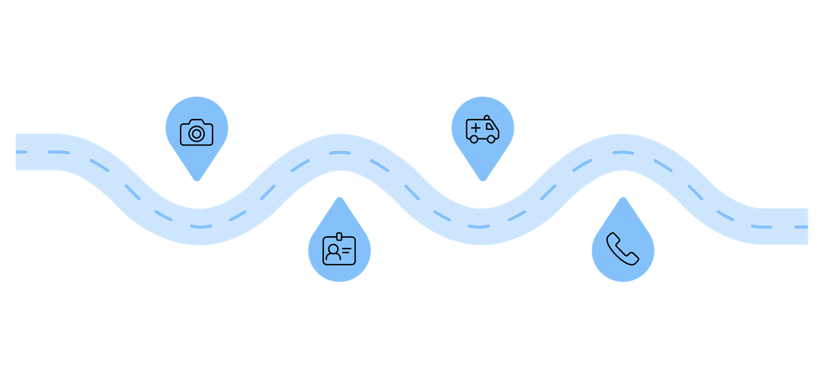




Live Demo: The Full Chain
Ambulance Dispatch
Bystander Photo
Capture victim image on-scene
Assign via Distance Matrix API
Face Match
Live Call
Return medical card under 10s
Voice agent calls reception live
What Judges Will See Live
Why Mock Calls Are a Strength
Real Twilio call placed to a friend playing hospital reception
Natural speech parsed by Google STT + Gemini into structured JSON on screen
Driver's phone GPS updating live on hospital dashboard map
SMS delivered to emergency contact on a third phone, shown to judges
Natural human speech is more ambiguous than a robot response. Our friends improvise. Gemini still parses correctly. In production: real hospital numbers. The technical proof is complete.
Every API in this demo is real. The only substitution is humans playing hospital staff — making the AI's job harder, not easier.

Slide 10
The Three Unfair Advantages
Voice Calls to Hospitals
Full Loop Ownership
Google-Native Architecture
No hospital-side integration required. Every hospital already has a phone. The cultural taboo around automating human calls is exactly what makes this defensible against copycats.
No incumbent owns victim identification through to ER pre-briefing. KAIROS is the neutral agent connecting all existing silos — identity, ambulance, beds, family, ER team.
Gemini · Google Maps · Google STT/TTS · Distance Matrix · Google Antigravity. For a Google hackathon, this is not just good practice — it is a strategic advantage.
When someone is found unconscious, a bystander photographs them — KAIROS identifies the victim, pulls their medical card, assigns the fastest ambulance, calls hospitals to verify a bed is actually available, and briefs the ER team. All autonomously. Before the ambulance arrives.

